Slide 1
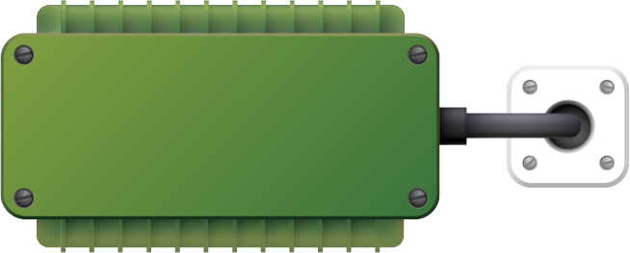

DIABETES MELLITUS PREDICTION IN PREGNANT WOMEN USING HYBRID DEEP LEARNING
TEAM MEMBERS:
VENKATA KRISHNAMANAIDU MANDADI
LALITH ADITYA CHINTAMREDDY
UMA CHANDRA
SHAMEER SHAIK

Slide 2
CONTENTS
INTRODUCTION
SYSTEM REQUIREMENTS
SYSTEM ARCHITECTURE
FLOW CHART AND ITS WORK FLOW
DATASET DESCRIPTION
IMPLEMENTATION AND SCREENSHOTS
PERFORMANCE METRICS
CONCLUSION AND FUTURE WORK

Slide 3
INTRODUCTION
Diabetes Mellitus is a major public health concern in our nation. It is a metabolic illness that affects thousands of people and is brought on by the body storing too much glucose. Diabetes can lead to several health problems in humans if it is not identified early on, such as heart disease, kidney disease, nerve damage, eye damage and more. Diabetes mellitus during pregnancy, known as gestational diabetes mellitus (GDM), poses significant risks to both the mother and the unborn child. Early and accurate prediction of GDM is crucial for timely intervention and improved maternal and fetal outcomes.
This study aims to predict the diabetes mellitus in pregnant woman using Deep learning Algorithm such as GRU+LSTM, GRU, LSTM, RNN and Machine Learning algorithms such as XG-Boost and Random Forest classifiers on a real-time diabetes dataset. To yield the best possible remedy for the diabetes mellitus prediction, extensive research and new methods such as SMOTE are considered in this job.

Slide 4
SYSTEM REQUIREMENTS
HARDWARE REQUIREMENTS :
Processor: Intel 15(8Gen)
RAM: 4GB (minimum)
Internal space: 20-30 GB
Hard Disk:1TB
SOFTWARE REQUIREMENT :
Operating system: window 10
Technologies used: AWS Cloud, Machine learning, Deep Learning
Framework: Flask
Programming languages: Python, Html, Css, Java script

Slide 5
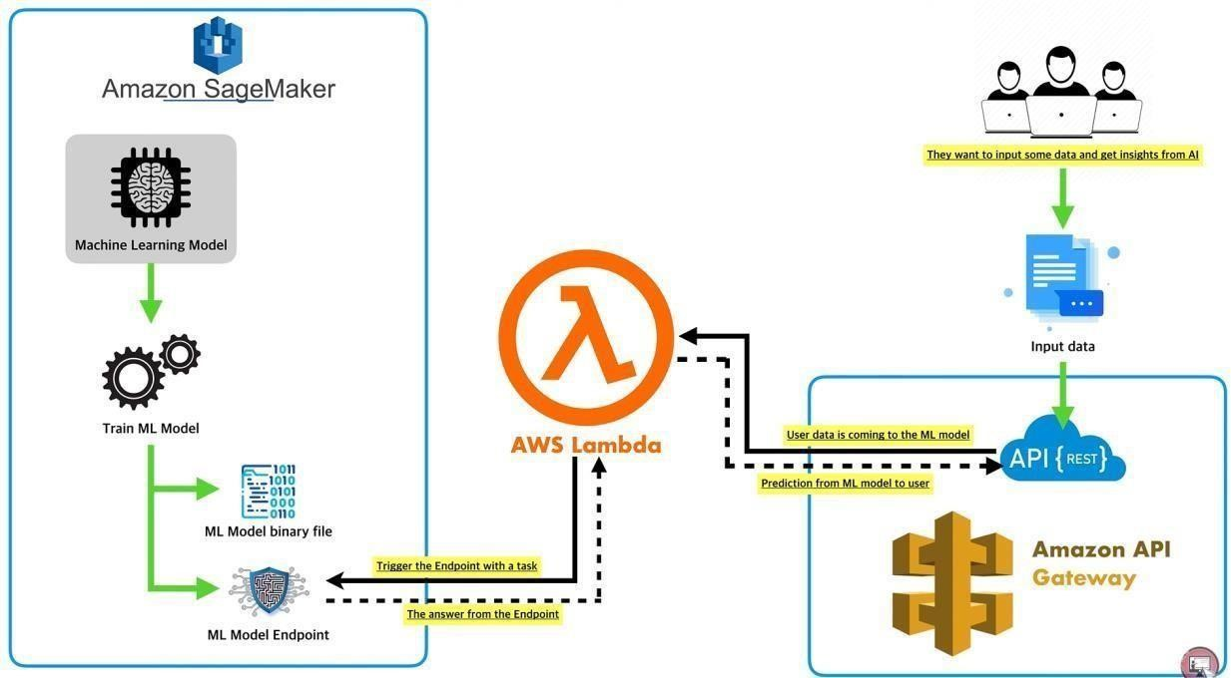
SYSTEM ARCHITECTURE

Slide 6
DESCRIPTION
These services often provide pre-configured instances with a range of hardware options you can select from. Explore options like spot instances, which offer unused cloud capacity at a discounted rate. This can be cost-effective for workloads that are not time-critical. Overall, the cloud offers flexibility in hardware selection. By understanding your model's needs, workload patterns, and budget constraints, you can choose the most appropriate hardware configuration for your cloud deployment. This approach leverages the strengths of SageMaker for deep learning model deployment, offering scalability, efficiency, and a more suitable environment for running complex models compared to AWS Lambda. API Gateway would act as the single entry point for all incoming requests.
It would be configured to handle different request paths or endpoints, each potentially corresponding to a specific prediction functionality of your model. By incorporating API Gateway into your cloud deployment strategy, you can create a well-structured, secure, and scalable interface for accessing the predictions generated by your hybrid deep learning model. This facilitates seamless integration with various client applications used by healthcare professionals. By effectively utilizing Amazon S3, you can establish a secure, scalable, and cost-efficient foundation for data storage within your cloud-deployed Diabetes Mellitus prediction project. This frees you to focus on core model development and improvement.

Slide 7
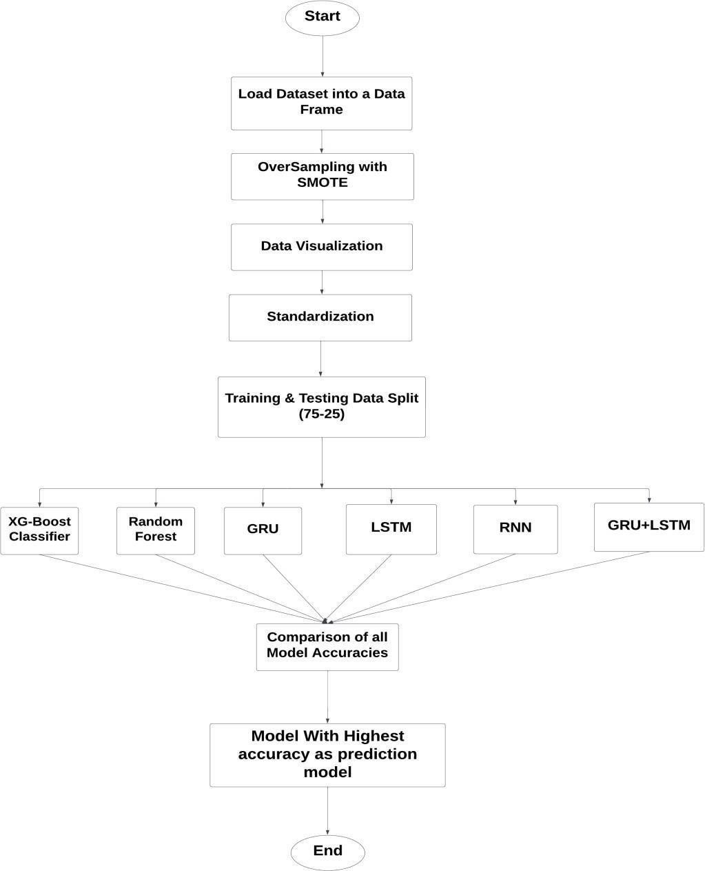
Proposed Work Flow Chart:

Slide 8
Proposed Work:
Step 1 (Import Modules): Importing essential libraries that are needed for the suggested job is the initial step. Graphs are created using the seaborn and matplotlib libraries. Training and testing splitter is implemented using scikit_learn library. Python's NumPy is used for mathematical and numerical operations, whereas pandas is used for data analysis and manipulation, usually with tabular data.
Step 2 (Loading Dataset): Start Loading the UCI dataset in the Training folder into the RAM during the runtime.
Step 3 (Feature Selection): The selection of features has a significant impact on machine learning models. Training the model with redundant data and meaningless characteristics can result in models that are faulty and provide incorrect predictions. The dataset was examined for missing or empty values. In any column, there were no missing or null values. The correlation matrix was then used to determine that no one feature was significantly correlated with the outcome. As a result, no feature was eliminated for correlation. Finally, outliers were discovered. Box plot approach was used in some columns. Outliers were left in the dataset because removing them from such a small-scale dataset resulted in worse performance. The dataset was therefore constructed with the relevant features.

Slide 9
Step 4 (Over Sampling Using SMOTE): After the loading of the dataset, the dataset was thoroughly analysed. The dataset was discovered to be unbalanced. In the result class, the non- diabetic to diabetes ratio was 1.86 to 1. Oversampling was used to balance out the dataset to alleviate this problem. Oversampling was accomplished using the Synthetic Minority Oversampling Technique (SMOTE). It evened out the distribution of classes by more frequently reproducing minority class samples, as random instances of minorities were mixed with smote to produce new instances. Following SMOTE, the diabetic to nondiabetic case ratio was 1:1, achieving our oversampling goal. The total number of occurrences became from 768 to 1000.
Step 5 (Data Visualization): This step is used to know the hidden relationship or pattern between the attributes. Bar plots display the distribution of categorical data; pair plots reveal relationships between pairs of variables; heatmaps visualize correlations or patterns in a dataset, and pie charts represent the composition of a whole as parts.
Step 6 (Standardization): As distinct attributes were measured on different scales, scaling them would level the playing field for all data points. The goal of scaling in this case is to reduce all features to a single scale. Because the majority of the algorithms utilized were gradient descent-based, feature scaling would minimize the step size, resulting in speedier outputs. Standardization was implemented in the dataset for scaling.

Slide 10
Step 7 (Train–Test Split): Using the scikit-learn library to access the 'train_test_split' function, which enables us to neatly divide the dataset into two parts: one for training and the other for testing. This Project gives the results of 75:25 ration split.
Step 8 (Model Building): Bring in the required model libraries, including Random Forest, XG-Boost, GRU, LSTM, RNN. Assign each of these models to its own variable for easy access.
Step 9 (Model Training): In this stage, the data is passed in the Dependent variable and independent variable separately into the model to train our model with our dataset, where it will find hidden patterns that help it in its prediction of classes for new/unfamiliar inputs.
Step 10 (Testing the Model): Provide input with the independent testing dataset and allow the model to predict target values. In this case, the model utilizes its learning from the training process to predict likely outcomes using the new and previously unseen data.
Step 11 (Accuracy calculation): Matching the actual world values of the dependent characteristic with those our model anticipated. With a tool such as a confusion matrix, can be useful to judge how good or not each model’s predictions perform. This enables to determine the level of success of our model within its practical relevance setting.
Step 12 (Accuracy Comparison and best model declaration): After obtaining the accuracy scores of all the models, then move to the final practical decision. Choose the best one or two exemplary models showing highest accuracy, and take this as the high rated models by this dataset. The best performing models are the ones that will be used in predicting and drawing meaningful conclusions in future.

Slide 11
DATASET DESCRIPTION AND SAMPLE DATA
https://www.kaggle.com/datasets/uciml/pima-indians-diabetes-database
The dataset used for the project is Pima Indian Diabetes Dataset from National Institutes of Diabetes and Digestive and Kidney Diseases. There is total 768 patients and all of them are females of at least 21 years old. The dataset has eight predictor variables and a target variable. There were 500 cases of non-diabetic patients compared to 278 diabetic patients. All the data of predictor variables were numerical and the target variable were categorical. The predictor variables are:
Pregnancy: Number of times the patient had been pregnant
Glucose in blood: Glucose concentration in 2 hours of oral glucose consumption test
Blood Pressure: Diastolic blood pressure in (mm Hg)
Fold thickness of skin (Triceps)
Insulin: Serum insulin in body after 2 hours of food intake. (μh/ml)
BMI: Body mass index of patient.
Diabetes Pedigree Function: Indicates the function which scores likelihood of diabetes based on family history or genetics.
Age of patient

Slide 12
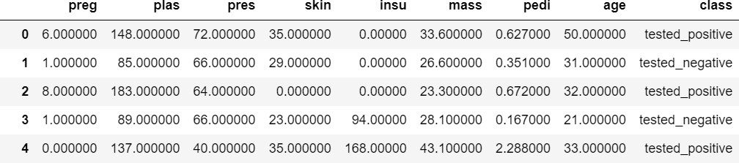
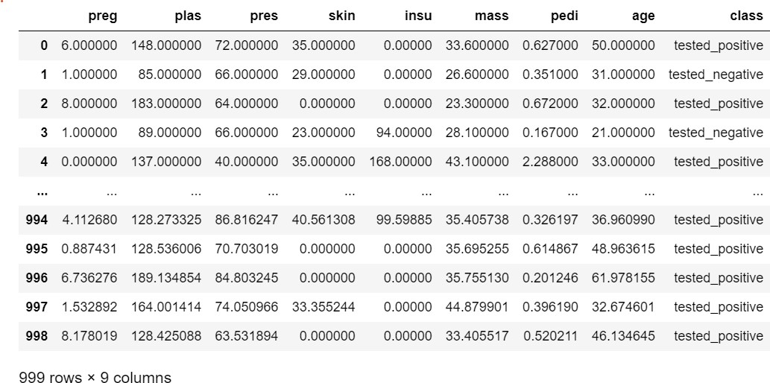
Sample data of Diabetes dataset
Sample dataset after Applying SMOTE

Slide 13
IMPLEMENTATION

Slide 14
HYBRID DEEP LEARNING RESULTS
Model | Accuracy | Precision | Recall | F1-Score
XG-BOOST | 86% | 0.86 | 0.86 | 0.86
RANDOM FOREST | 85% | 0.85 | 0.85 | 0.85
GRU | 90% | 0.8930 | 0.8933 | 0.8933
LSTM | 82% | 0.7630 | 0.8443 | 0.8016
RNN | 96% | 0.9554 | 0.9678 | 0.9678
GRU+LSTM | 99% | 0.997 | 0.997 | 0.998

Slide 15
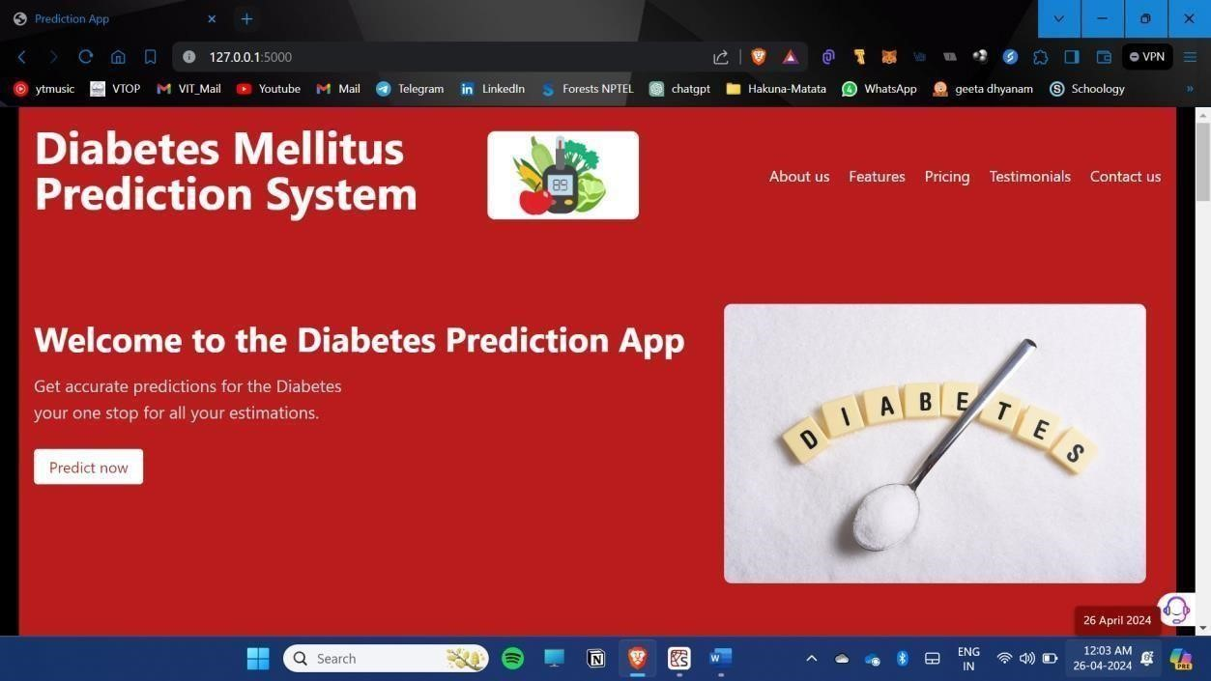
WEB PAGE DEVELOPMENT

Slide 16
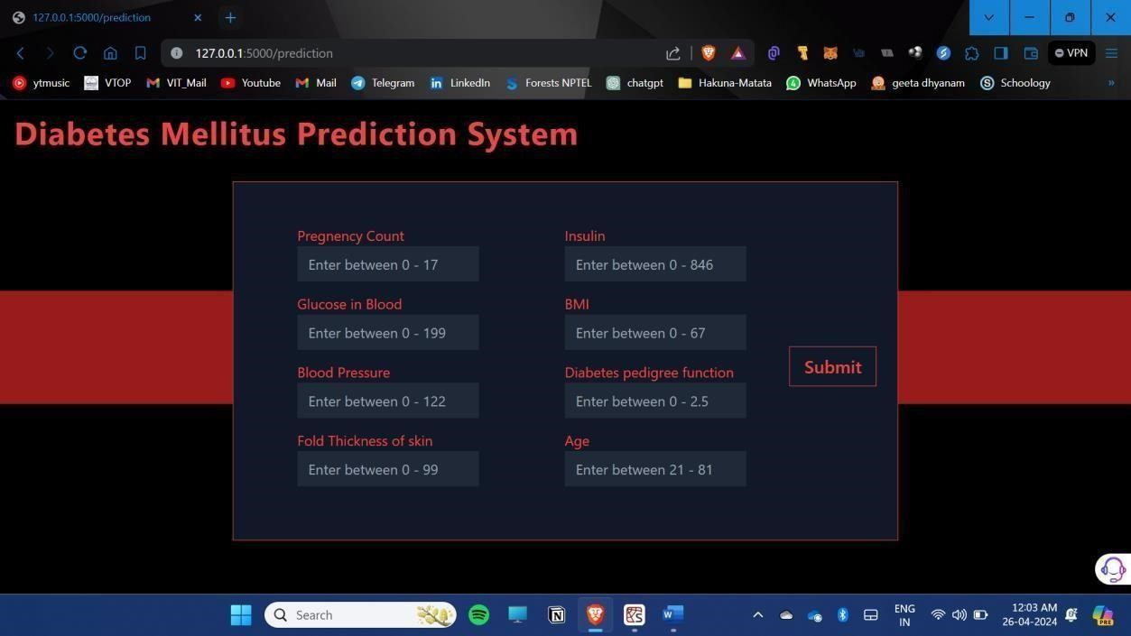

Slide 17
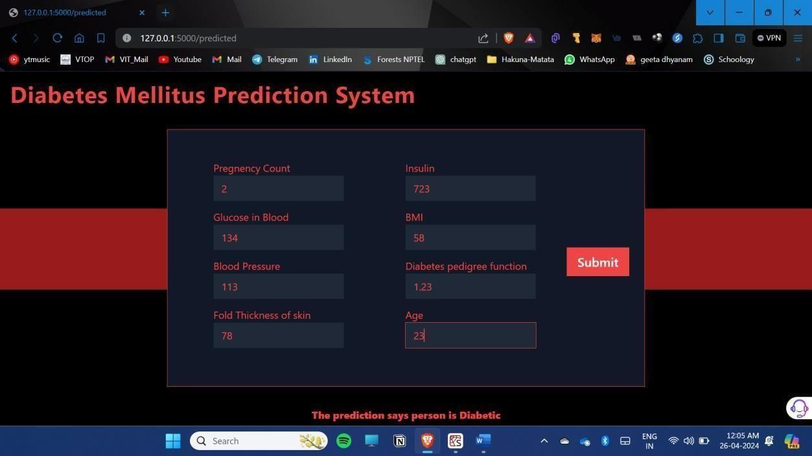

Slide 18
DEPLOYEMENT OF DIABETES MELLITUS PREDICTION IN PREGNANT WOMEN USING HYBRID DEEP LEARNING IN AWS SERVERLESS LAMBDA AWS SERVICES LIKE: AWS SAGEMAKER API GATEWAY LAMBA FUNCTION S3(STORAGE BUCKET)

Slide 19
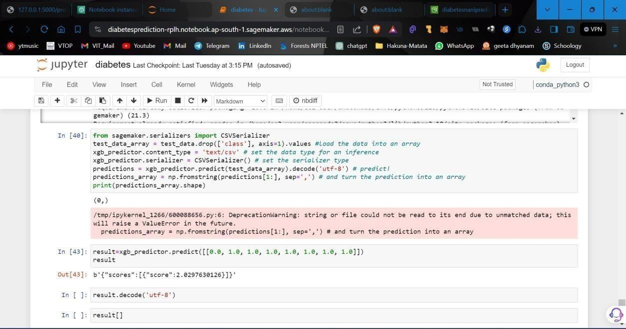
OUTPUT SCREENSHOT

Slide 20
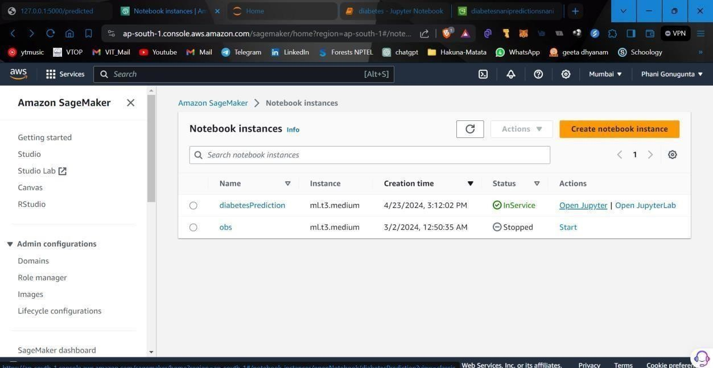
SAGEMAKER

Slide 21
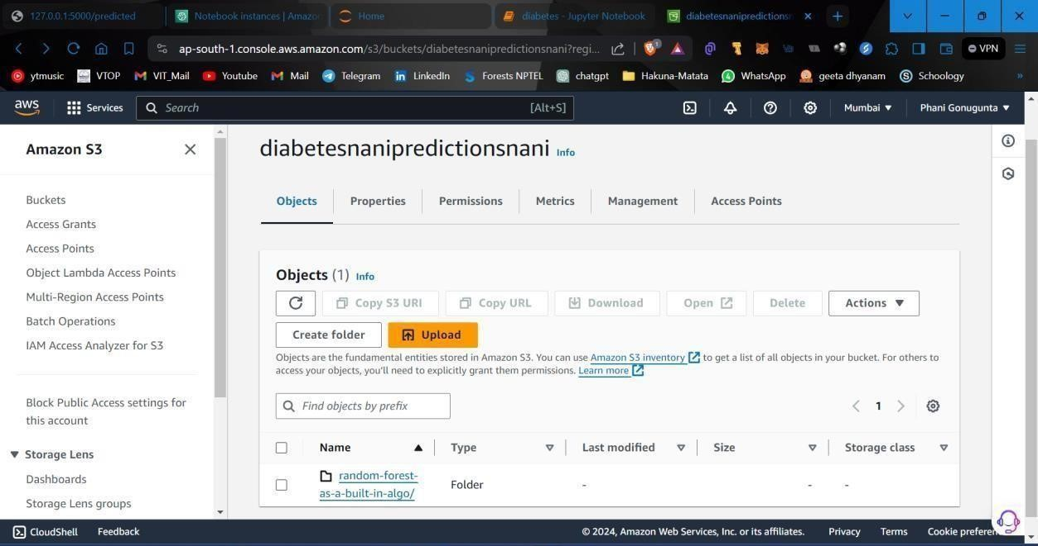
AMAZON S3

Slide 22
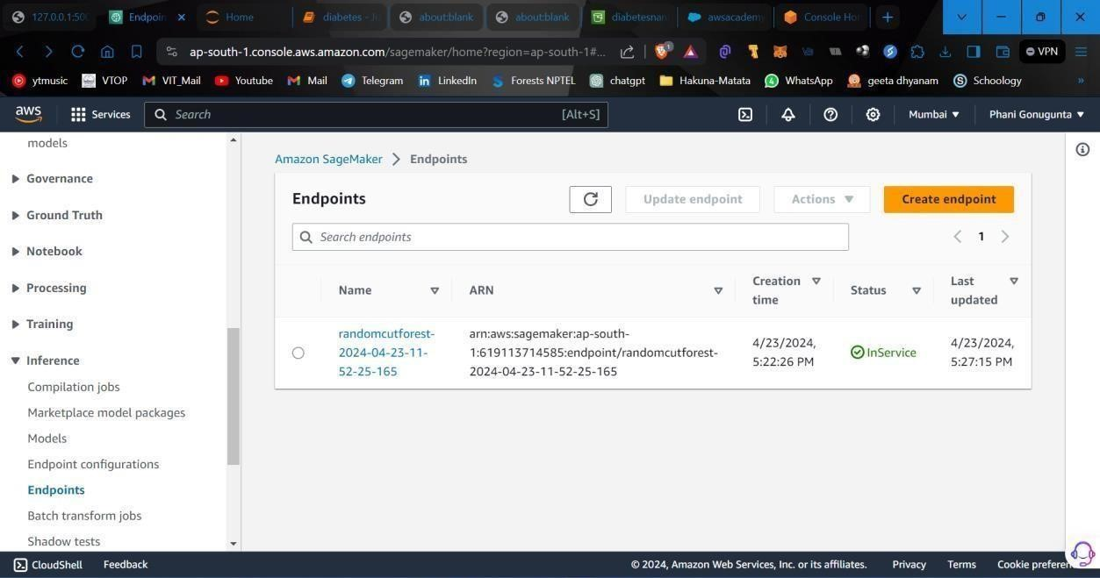
ENDPOINTS

Slide 23
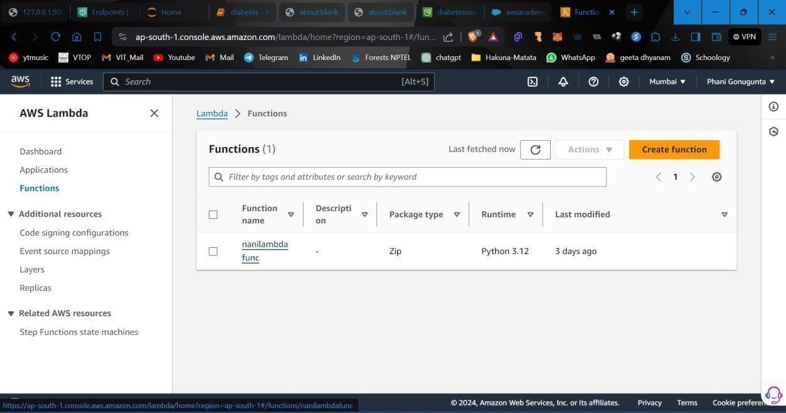
AWS LAMBDA

Slide 24
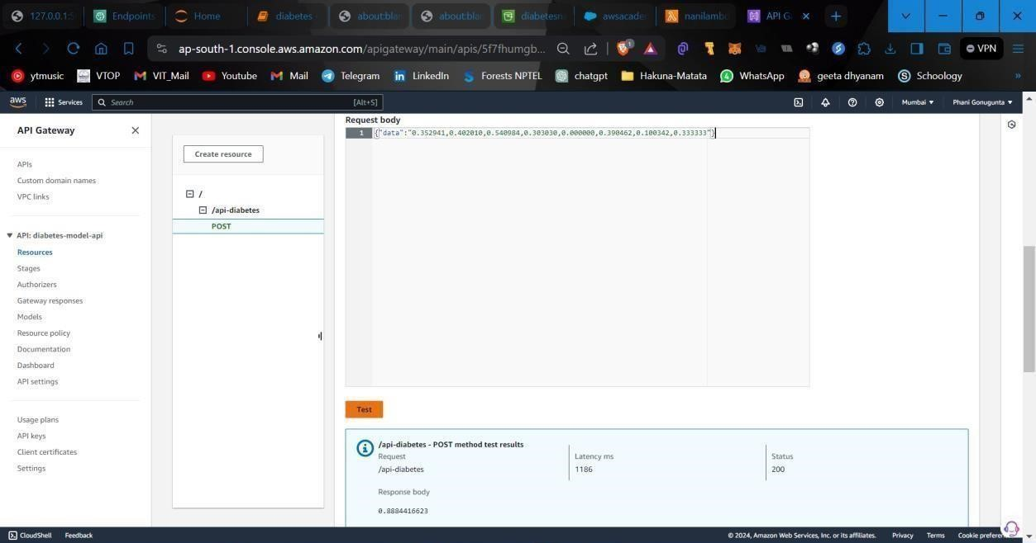
API GATEWAY

Slide 25
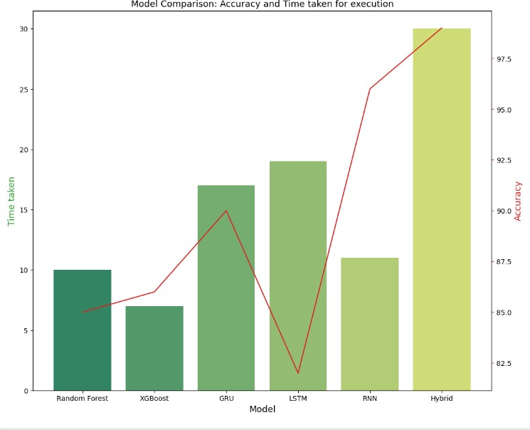
PERFORMANCE METRICS
Comparison between Accuracy and time taken for execution

Slide 26
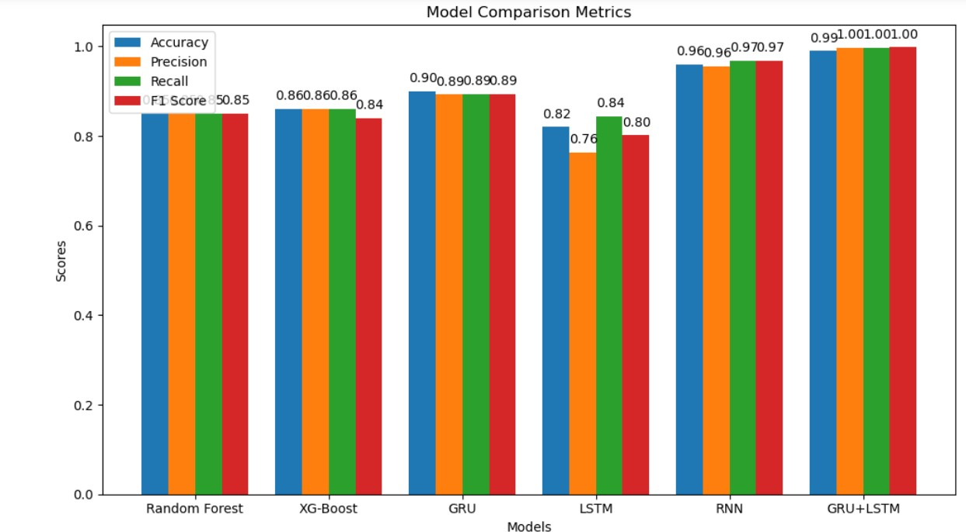
MODEL COMPARISION METRICS

Slide 27
CONCLUSION AND FUTURE WORK
This project aimed to develop accurate diabetes prediction models using a combination of machine learning and deep learning algorithms. The dataset used was the Pima Indian Diabetes Dataset, which initially had an imbalance in the distribution of diabetic and non-diabetic cases. The Synthetic Minority Over-Sampling Technique (SMOTE) was applied to address this imbalance, resulting in a balanced dataset. The models compared in this study included XG- Boost, Random Forest, GRU, LSTM, RNN, and a hybrid GRU+LSTM. Each model was trained and tested, and their performances were evaluated based on accuracy, precision, recall, and F1-score. The results showed varying degrees of success for each model, with GRU+LSTM demonstrating the highest accuracy at 99%.
The comparison charts demonstrated the differences between accuracy and execution time, offering an in-depth overview of the models' performance. GRU+LSTM performed not only in accuracy but also in competitive efficiency, making it a promising choice for diabetes prediction. In the future, we can improve the models by trying new ensemble techniques, adjusting settings for better results, and testing on different datasets. We should also make the models easy to understand and keep them updated with the latest information for better predictions about diabetes.

Slide 28
THANK YOU

